Slide 1


Materials Informatics
Name
Aryan Shukla
Mehul Shakya
Saksham Tripathi
Enrollment number
20118016
20411017
20118073
Notes:
Good afternoon everyone, we are group 7. I am Mehul, this is Aryan and Saksham. Now let’s dig in.

Slide 2
Problem statement
Differentiate between Conductors and Insulators.
Taking different types of materials present around us. They are often used in electrical applications. But which one to choose?
Conductors and Insulators are a very broad classification in material sciences. To differentiate between them is what we will be walking you through.
Notes:
This is our problem statement. We are surrounded by millions and billions of different types of material. They have their role in electrical applications. But which one to use where. So, we are here to classify conductors and insulators.

Slide 3

Database
Importing all the data from
Materials project https://materialsproject.org/
Used tool
MPRester
This helped to fetch the relevant data by providing APIs.
Notes:
Starting with collecting all relevant properties’ data. We used materials project to import the data using MPRester, which helped us to fetch the relevant data by providing APIs.

Slide 4
Preprocessing
Data was already cleaned.
No need for rescaling or standardizing.
Need to rescale the probability as it was tending to zero, we took the log of them.
Also, to render the graphs we rescale them.
1
Notes:
Preprocessing is the process we must go through to make the data usable for further application. The data we extracted contained no null values, also in classification there is no need for rescaling or standardizing. But the probability was very close to zero, so we rescale it by taking log. This also helped in rendering the graphs. Now handing over to Aryan.

Slide 5
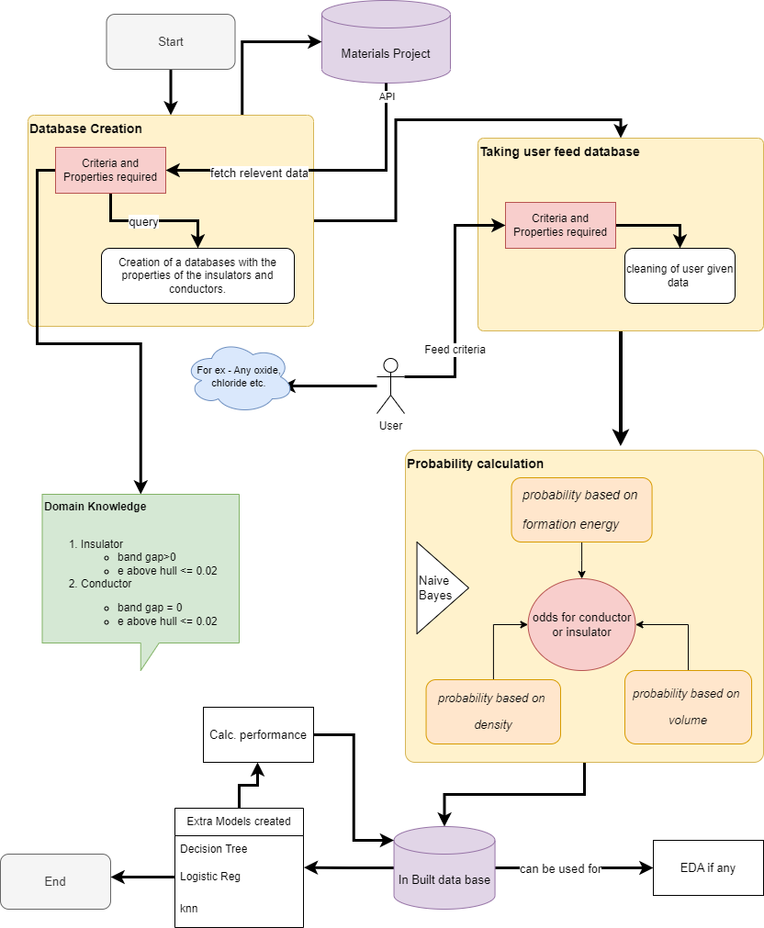
Notes:
We follow this flowchart for the project

Slide 6
Discussion
We can predict on the basis of the probability that if one property of a material falls in a certain region it is a conductor or insulator. Different plots are shown and more can be drawn.
Notes:
Thanks Aryan, now let’s discuss what we got. Classification is broadly about categorizing the data. What could be a better way to do EDA(extrapolatory data analysis)? We can say a material is allowing electrons through it by looking in which region it lies. We plotted various graphs some are here.

Slide 7
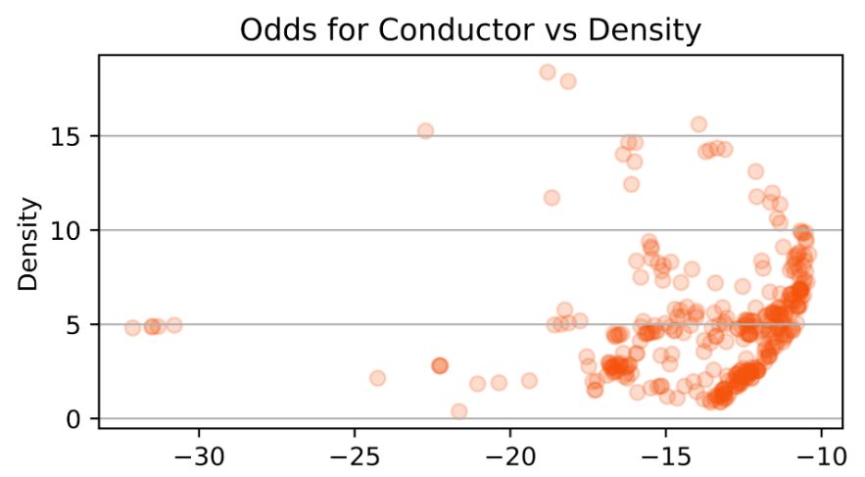
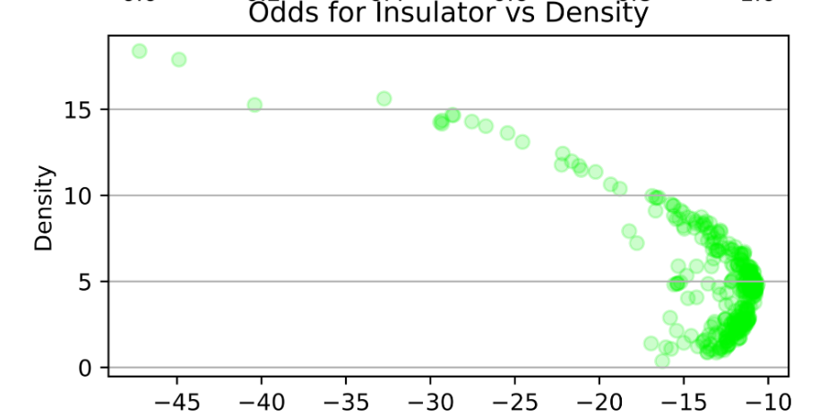
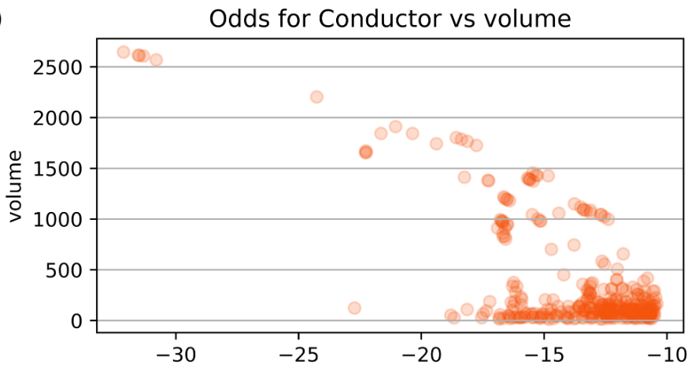
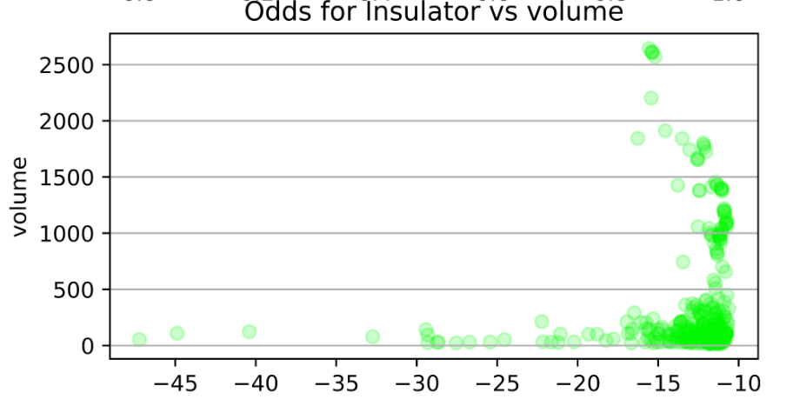
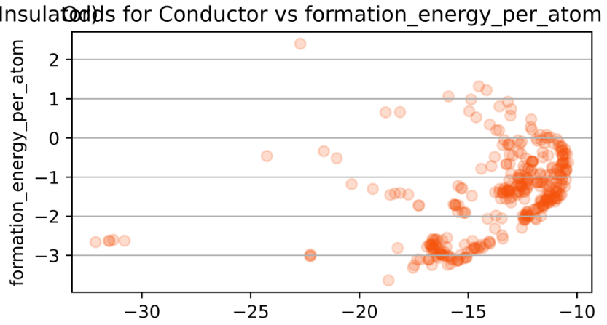
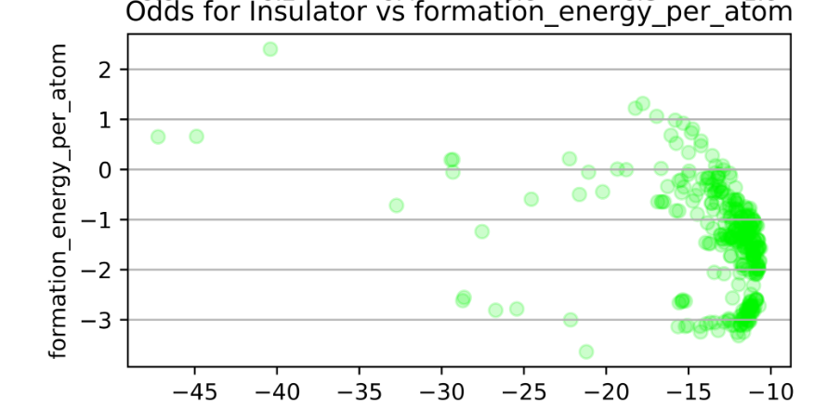
Odd
Note: Taken the log of the probability as the values were too close to zero.
Notes:
So, the odds of a material being an insulator or a conductor vs the property are here. The x-axis here has negative values because as Mehul said earlier the probability was very close to zero, so we took the log of the probability to rescale it and render the graphs. As these graphs have similar probability density, to classify them as a conductor or an insulator we compare the odds of them against a certain property.

Slide 8
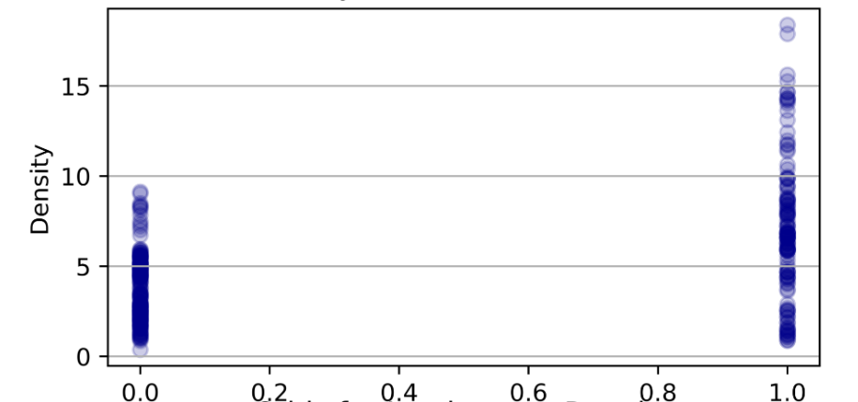
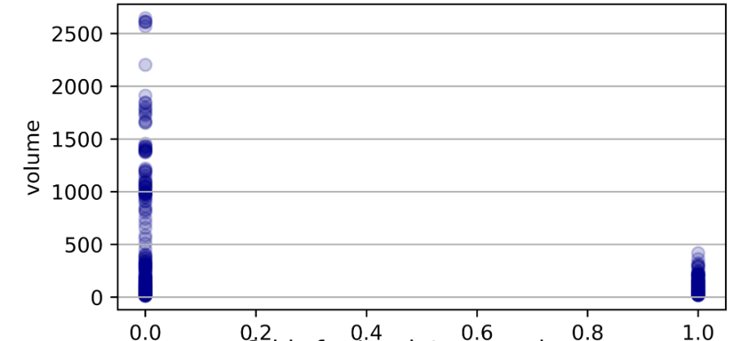
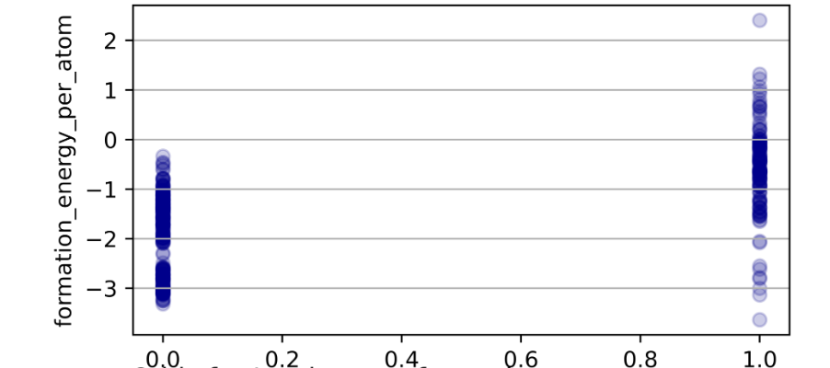
Material vs ***
0 for insulators
1 for conductors
Notes:
Comparing odds of different properties and their inclination towards conductor or insulator we predict whether a material is predominantly a conductor, or it is an insulator. Like if the density of a material is greater than 10, we can say it carries a high chance of being a conductor also if it is less than 5 the probability of it being an insulator is quite high. Similarly, for unit cell volume if the value exceeds 500 its chances of being an insulator are high. A similar depiction can be drawn for formation energy per atom.

Slide 9
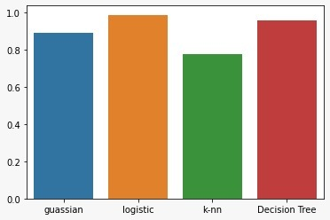
Conclusion
We made a correlation matrix. Showing the dependence on one factor over the other.
GaussaianNB (from naïve_bayes, sklearn)
Logistic regression
K-nn classifier
Decision tree classifier
Then we plotted the confusion matrix and extracted the classification report.
Based on the accuracy we conclude Logistic Regression model is the best.
Notes:
Now let’s conclude. After plotting the graphs, we move on to make models. First, we made a correlation matrix to show the dependence of one factor on the other. After that, we used 4 models which are…
After this, we made the confusion matrices and report on our classification which showed us the accuracy,f1_score, etc. The highest value of accuracy was given by logistic regression, so we conclude it is the best model.

Slide 10
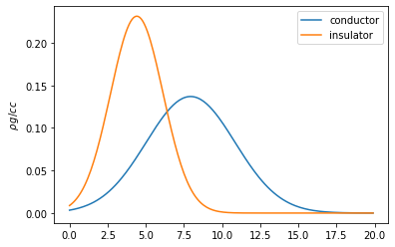
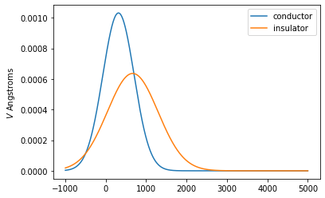
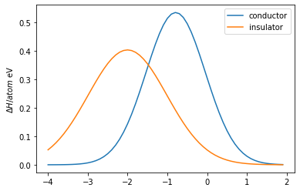
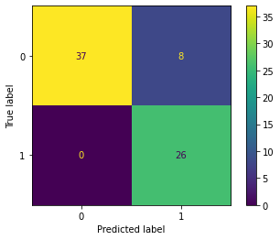
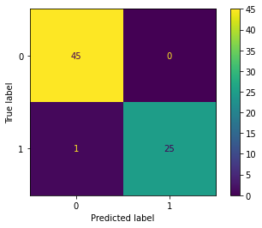
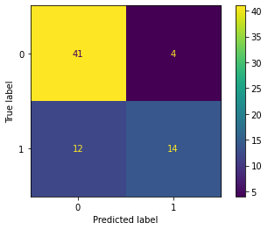

Appendix - Plots
Gaussian Plots
Density
Volume
Formation energy per atom
Confusion
Matrices
GaussianNB
Logistic Reg
K-nn classifier
Decision Tree
Notes:
These are some of the plots that assist us in the project.

Slide 11
THANK YOU
Notes:
This is all from our side. Thanks for being an interesting audience. Thank you.

